Slide 1
StockNET:
A Distributed
Trading Competition
John Lee and David Simonetti
Notes:
Hi everyone, I’m david and im john, and this is our project titled Stocknet: a distributed trading competition. We will start with a discussion of the design goals of our system.

Slide 2



Design Goals of StockNET
Simulate trading on the stock market
Clients create account
Buy/sell operations
2. Each client has delayed information
a. Broker has updated info
b. Variable delay to client
3. Competition between trading strategies
a. Global leaderboard
b. LFT/HFT
Notes:
Here are the design goals and problem we are trying to solve with stocknet. We are trying to simulate trading stocks on the stock market, where a client can come create an account with a starting amount of 100,000 dollars and then is able to perform buy/sell operations on the market. The prices are determined by a market simulation that publishes the prices to clients, but with a twist. Clients have delayed information, so a price they receive will always be a fixed amount out of date. The server that completes their buy/sell requests-the Broker- has a direct connection to the market and receives the most up to date information. Finally, we wanted to include a competition between players in our game. There is a global leaderboard which shows who has highest net worth of everyone playing the game, which will allow people to test and develop different strategies. Some of these might include LFT and HFT, which refers to how often buy/sell requests are done.

Slide 3
Architecture - Definitions
Simulator
Replicator
Simulates stock market
Pub/sub to deliver prices
Latest info to Broker
Stores client info
Txn and Ckpt
Crash recovery
Client
Broker/
Load Balancer
Create account
Buy/Sell/Balance ops
Get Leaderboard
Handles client ops
Hash Client to Replicator
Async requests
Notes:
There are 4 main components to our system architecture. We have the simulator, which simulates the actual stock market and uses a pub/sub system to deliver stock price information to clients. The broker also has a direct connection for the most up to date information. The client is the user interface to the system, which allows buy/sell/get balance, and leaderboard operations. We also have replicator nodes, which store client information. They have a txn and ckpt to ensure consistency when handling client operations, and can be restored from these files if they crash. Finally is the broker/load balancer, which handles client operations. The broker is connected to potentially many replicators, and so after accepts client requests, it hashes the username to one of the replicators. It then fufills the requests asynchronously so that the throughput of all connected replicators can be used.

Slide 4
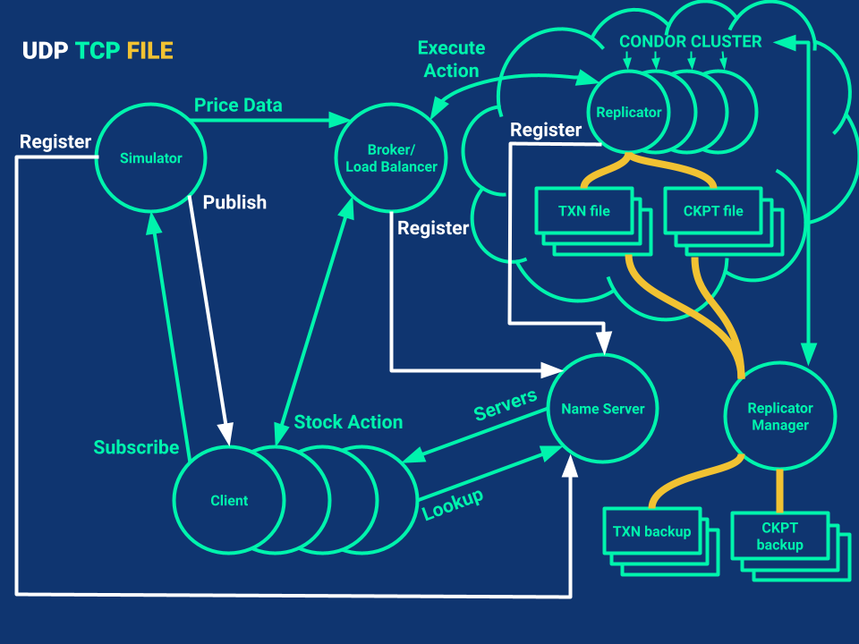
Architecture - Overall
Notes:
This is an overall diagram of the architecture of our system. This is really complicated, so we will be breaking it down in the next couple of slides. Some things to note are the simulator in the top left, the clients in the bottom, the broker in the middle top, the replicators in the top right corner, and the replicator manager in the bottom right.

Slide 5
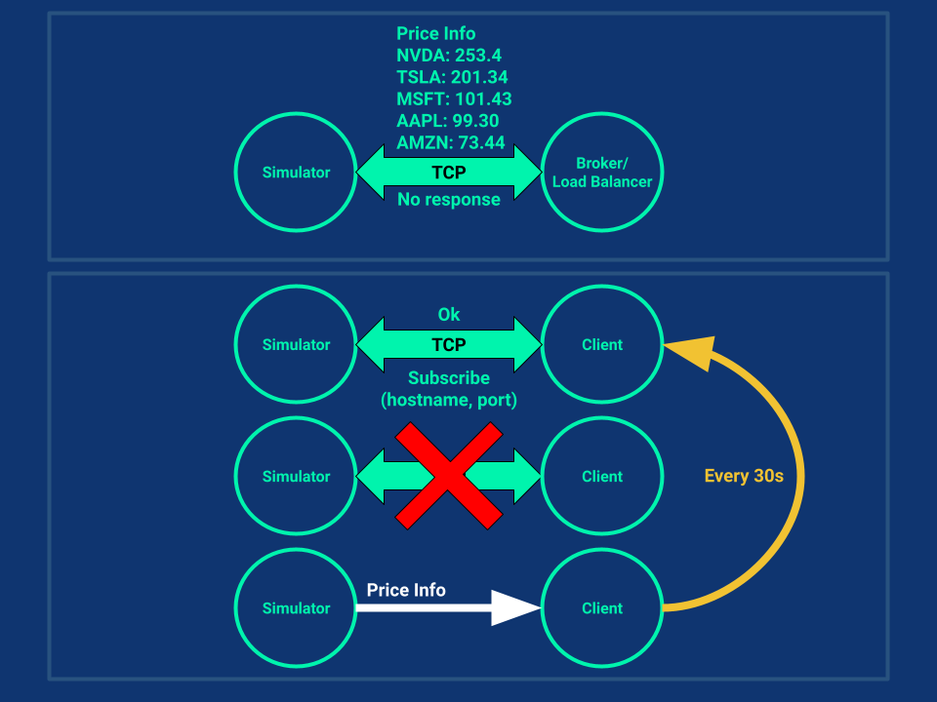
Architecture - Simulator
Notes:
This is the architecture of the simulator. In the top view, you can see the single TCP connection that the simulator has with the broker to deliver up to date stock information. On the bottom, you can see the pub/sub system where clients establish a TCP connection to the simulator to subscribe for stock info, and then receive the info on a UDP port. The clients must subscribe every 30s

Slide 6
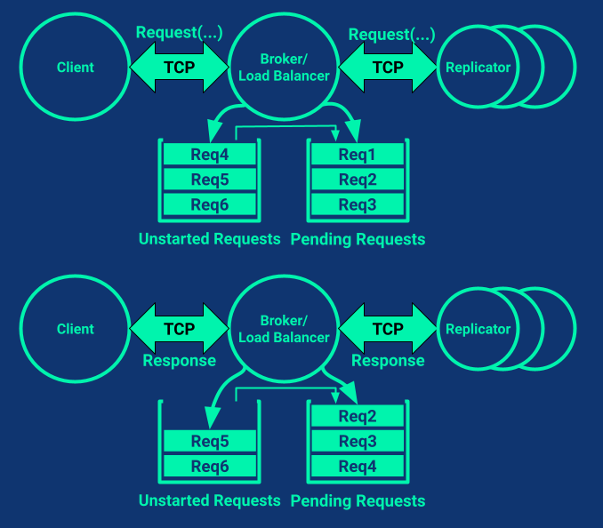
Architecture - Broker
Notes:
This is the architecture for the broker. The broker is both connected to many clients and many replicators. The broker accepts new client requests, forwards them to the replicator that they hash to, and then forwards them the response from the replicator when the operation finishes. It also keeps two queues of operations currently running on replicators and operations that are paused because the server is busy or crashed.

Slide 7
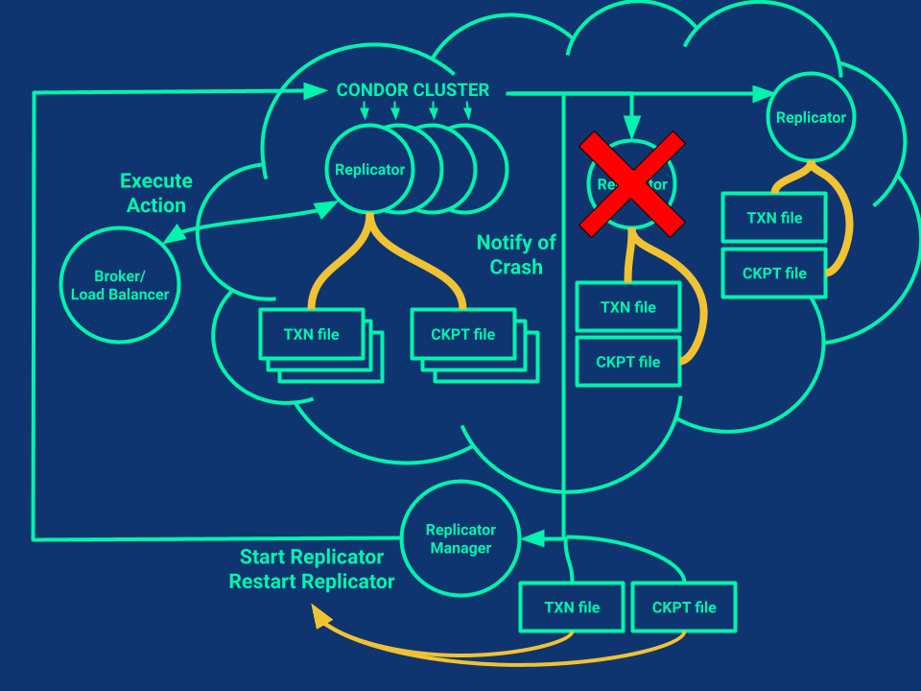
Architecture - REplicator
Notes:
This is the architecture for the replicator system. We use condor to provision nodes to run replicators on, and we use a replicator manager to handle the whole process. The manager starts up as many replicators as requested, and monitors the processes to see if they crashed or stopped. If either of those happen, condor notifies the manager along with sending it the state of the txn and ckpt logs, and a new replicator is started by the manager. This allows for as many replicators to fail and the system to continue to function.

Slide 8
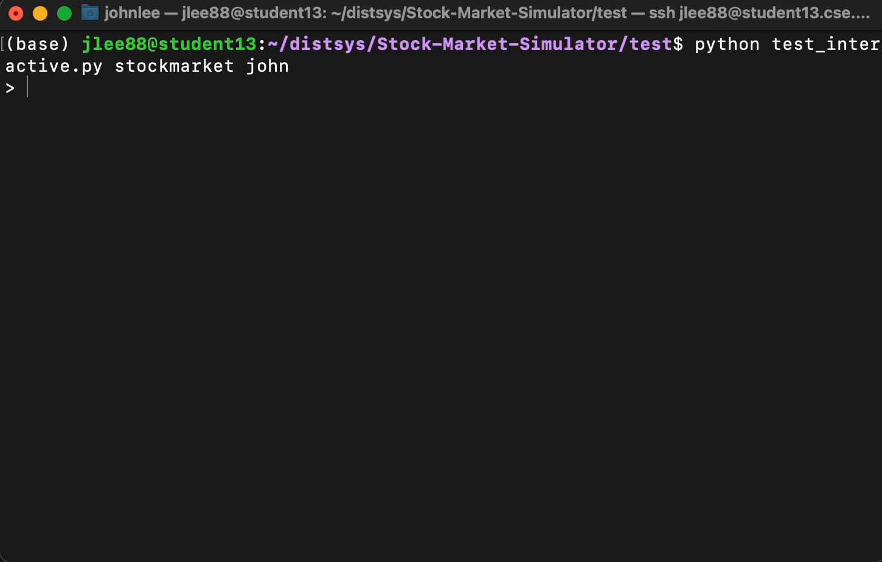
Client Interface/Example
Notes:
In this following video, we utilize an interactive client to demonstrate the set of API calls available to a client. Before I play it, I would like to point out that our system was designed for automated strategies and utilization of the system manually is for demonstration purposes only and would not be recommended. In the demo, we are able to retrieve the current prices of each stock, which is actually updated asynchronously through a daemon thread.
We also have the options of buying and selling shares, as well as observing your balance.
Lastly, you can poll the leaderboard to observe your current ranking, and in this demo I’m in last place…

Slide 9
Evaluation Metrics
Consistency/Persistence
Client accounts should be persistent
System can detect and recover from errors
2. Throughput
Maximize the ops/sec for all clients connected
3. Latency
Minimize the latency of Buy/Sell operations.
Maintain fairness of latency between HFT and LFT.
Notes:
We had 3 main problems we wanted to account for, in this order. First, consistency and persistence. if a client disconnects, they should be able to log back in through the same account and continue where they left off. On the other hand, if a replicator should go down, the system should be able to recover and continue running. One thing to note is that we didn’t account for our simulator failing, since a real life equivalent would be similar to the NYSE stock exchange failing.
Our other two problems were maximizing throughput, and minimizing latency, as well as maintaining fair latency between LFT and HFT traders.

Slide 10
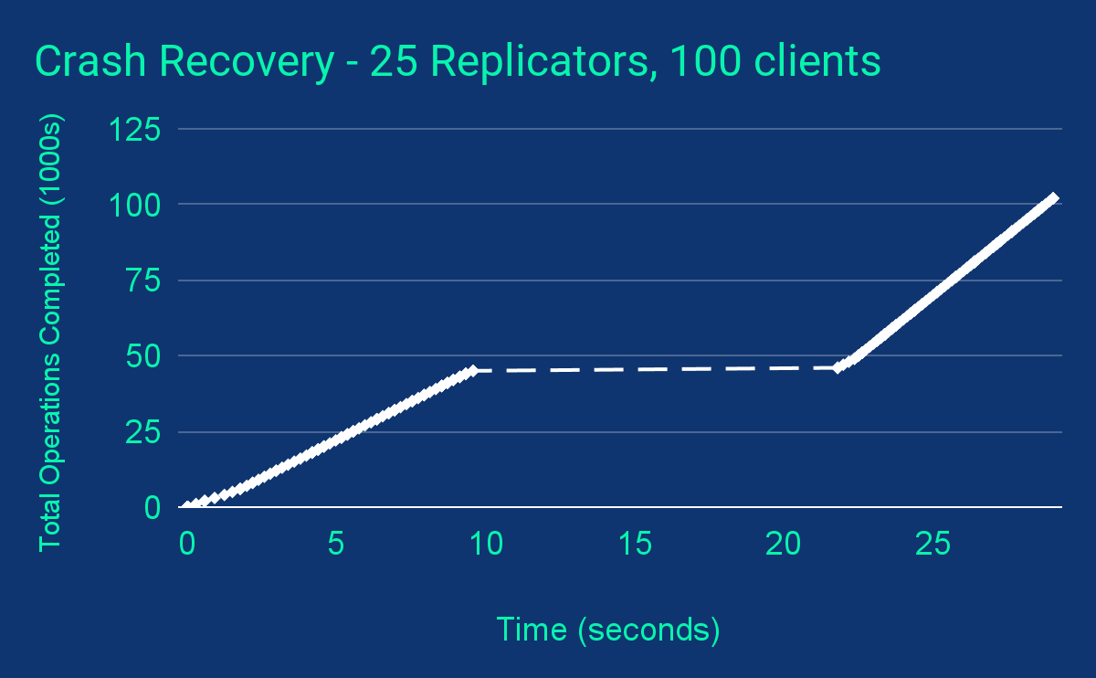
Evaluation - Consistency
All Replicators Crash
Replicator Rebuild Complete
Notes:
In this first plot, we evaluate the consistency of our system. It starts off linearly because the system is working at max throughput to fulfill client requests. We then killed all 25 replicators. The system stopped being able to process requests because all the replicators died. It took the replicator manager about 10 seconds to restart them from the state they crashed in. Once the replicators are rebuilt, the system returns to servicing clients

Slide 11
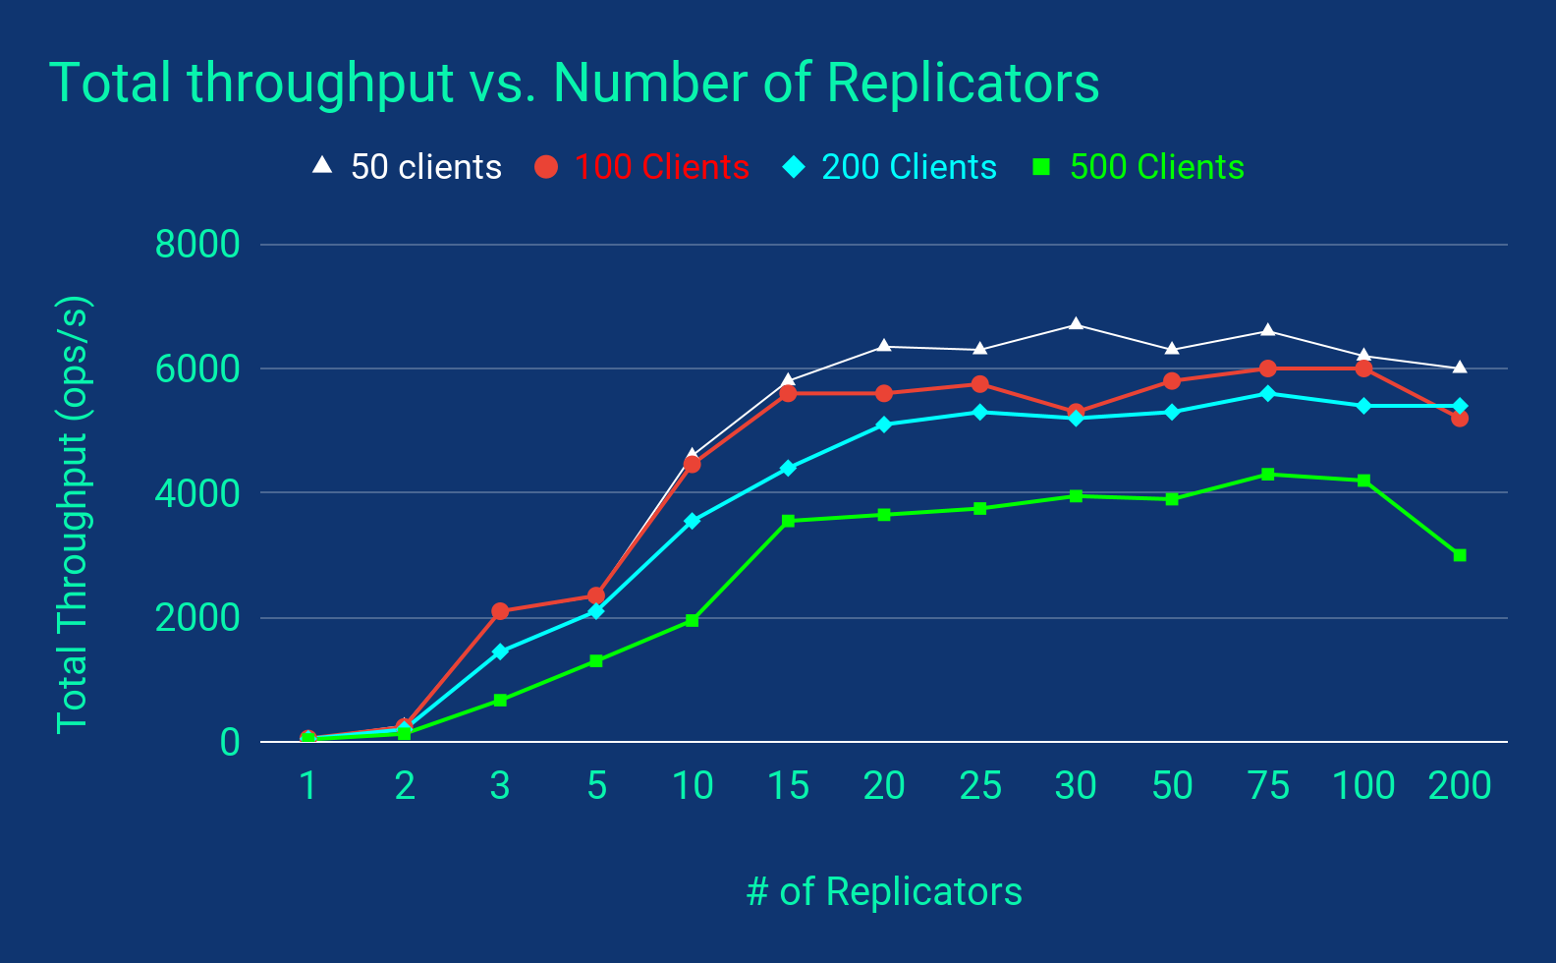
Evaluation - ThroughPut
Notes:
To evaluate the throughput of our system, we observe the Total throughput of 50, 100, 200, and 500 clients sending orders as fast as possible, and how that changes as the number of replicator servers increases.
We see that the from 1 - 15 replicators, we see quite a significant improvement in throughput across client count. However, it then starts to plateau and oscillate. In an ideal system with a uniform hash, we would only start seeing leveling off when the number of servers reaches the number of clients, since each server handles 1 client’s requests.
However, with our architecture, the load balancer itself seems to be a bottleneck so adding more than 15 replicators isn’t all that helpful.

Slide 12
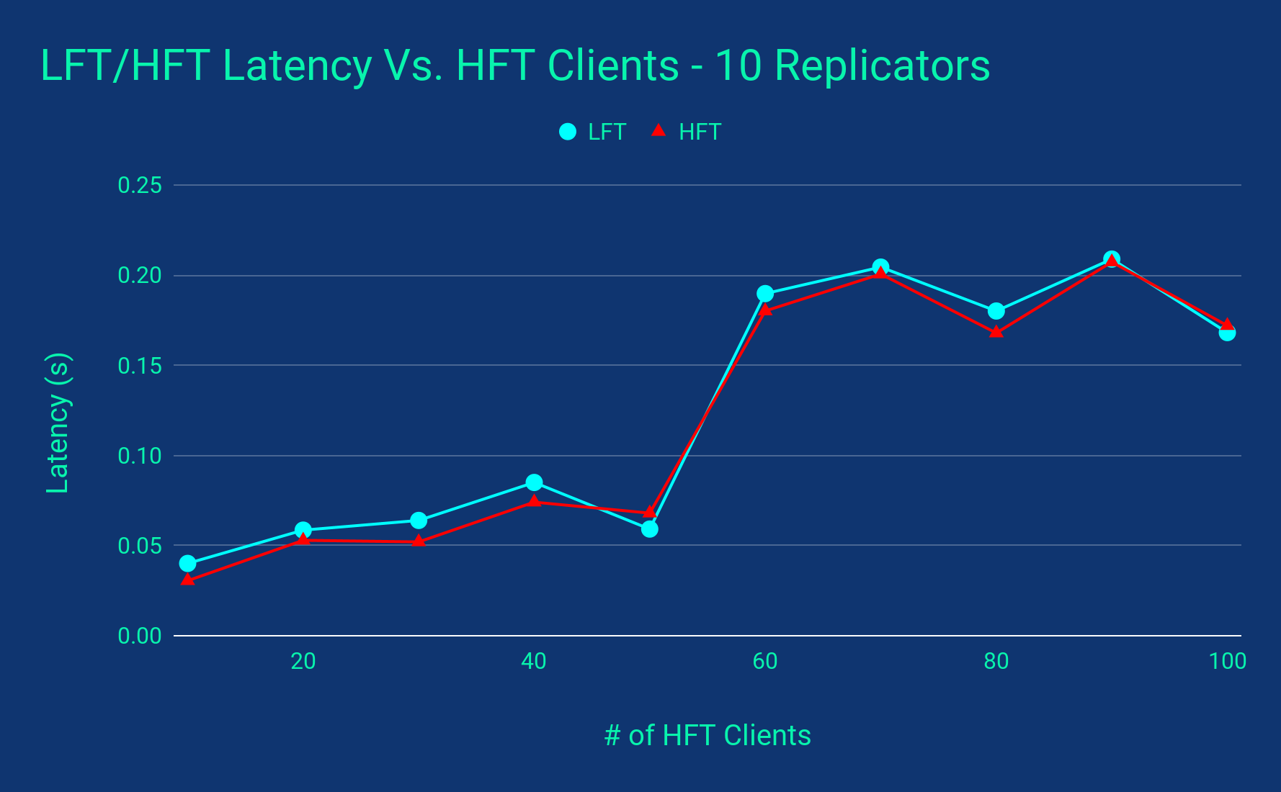
Evaluation - Latency
Notes:
In this graph, we wanted to observe the average latency of buy/sells for a HFT and a LFT, as the number of clients who just spam requests increase. Here, we arbitrarily chose 10 replicators to test on.
First, we can see the latency go up pretty significantly as the number of clients increase, particularly at around 50-60 clients. We suspect this may be the point that the load balancer can no longer keep up with the inflow of requests.
Overall for fairness, it seems like the LFT and HFT latencies could be insignificantly different, but the LFT seems to have marginally more latency than the HFT at most points.

Slide 13
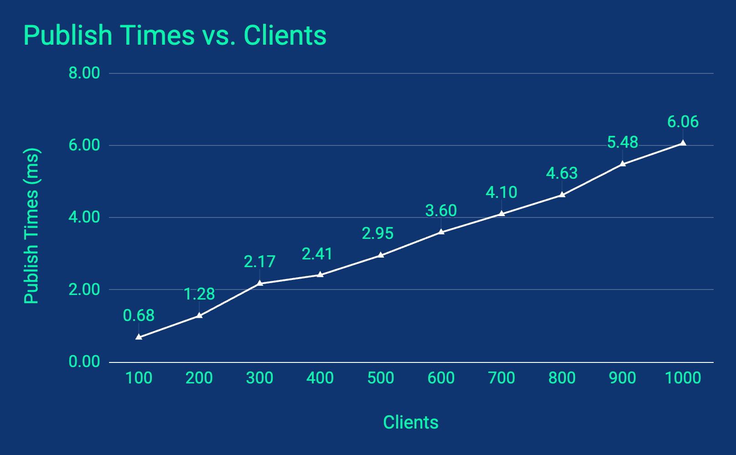
Evaluation - simulator
Notes:
Lastly, we wanted to make sure our simulation scheme was capable of publishing , and ran some tests regarding how long it takes to publish to all clients. In this graph, we averages publish times at 100 - 1000 clients and observe that even at 1000 clients the publish time is only 6 ms. In comparison, our update interval for the true value of of the stock is 10 ms. Furthermore the actual publish interval to clients is 100 ms.
Overall, we could handle significantly more clients through the simulator than the other parts of our architecture can handle right now.

Slide 14
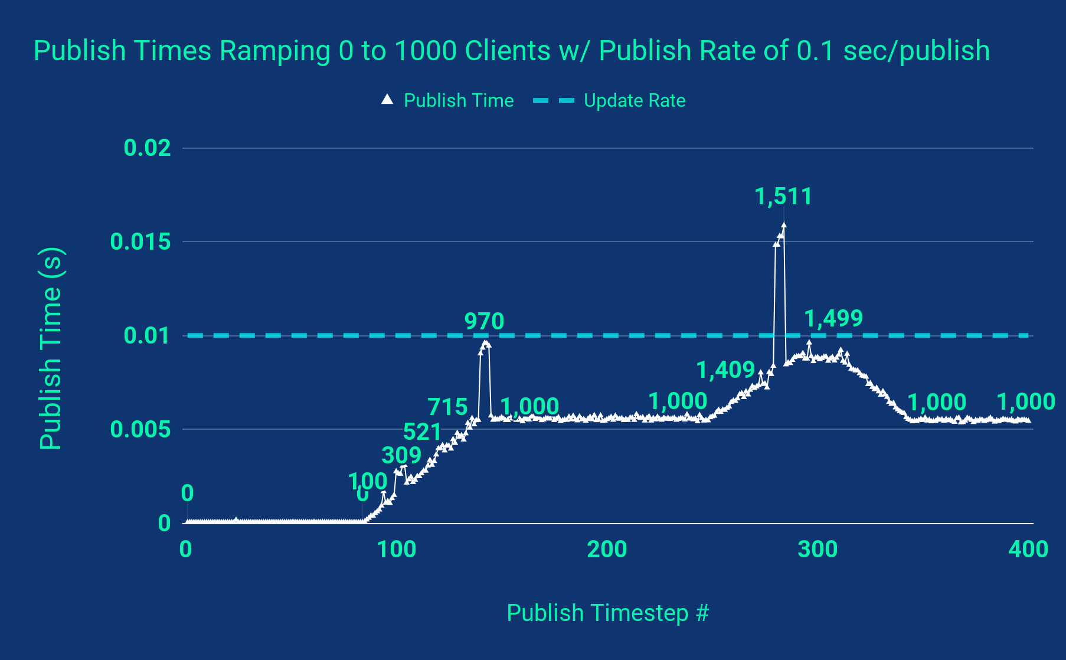
Evaluation - simulator
Notes:
We also wanted to observe how the publish times changed as clients resubscribed and were unsubscribed.
We observe pretty much a linear increase in publish times ramping from 0 - 1000, as shown previously. Then after leveling off, clients begin resubscribing before they get unsubscribed, resulting in about 500 duplicated clients due to our scheme of tracking clients. As all the duplicate clients get removed, the times level back off.
In 2 places, there are significant spikes in publish times which we could not find a full reason for. We theorize that it could be due to context swapping of processes or just hiccups in performance from other processes. However, we might note that the second one actually goes beyond our update rate, and will cause our simulator to skip a few updates. This is not a problem as long as we change our updates to be asynchronous.

Slide 15
Strategies
Random
50/50 to buy or sell 1-15 shares of a particular stock
User Strategy
John
For 100 publishes, determine the value of each stock by multiplying the probability of going up/down by the average up/down movement
Select the highest value to ALL-IN on for the next 500 publishes
David
Take John’s strategy but select the lowest value to ALL-IN on
Notes:
Lastly, we wanted to evaluate some strategies and their performance over time.
First, we have a random strategy that just buys or sells 1-15 shares uniformly of a stock with a 50% chance each.
Then I implemented a strategy where for 100 publishes I determine the expected value of a stock assuming it continues with the same distribution of performance. Of the 5 stocks, I select the highest expected value to all-in on for the next 500 publishes.
David’s strategy was to use mine, but selected the lowest value to all in on.

Slide 16
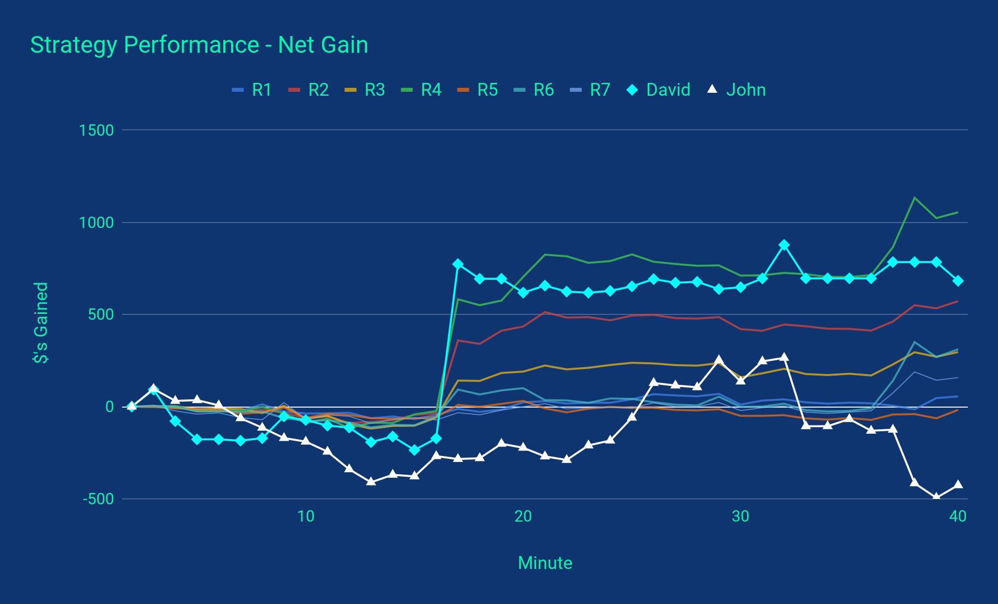
Strategy Performance
Notes:
And of course, after running for 40 minutes, David largely performed me because why would any strategy I make work…
Actually, it seems like there was just a point where a particular stock did really well and David happened to capture that moment. The more transparent runs are just random clients.

Slide 17
Thank You!

